Slide 1
The M-Factor
Round 2: Case Study
Candidate name: Vu Ta Duong

Slide 2
Part 1

Slide 3
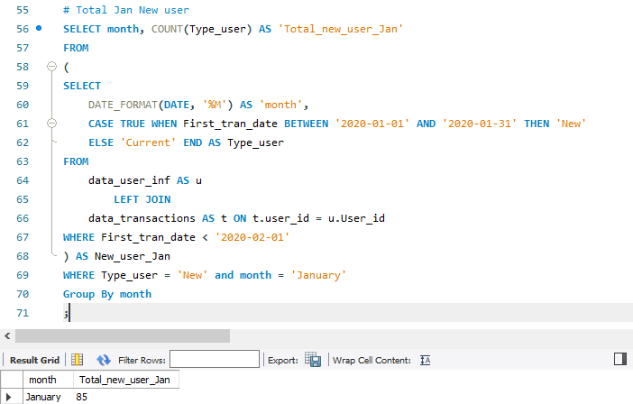
Part 1
Part 1.2
Total New Users in January : ………85…………….
Data : [https://github.com/atmen1997/Projects/tree/main/Momo]

Slide 4
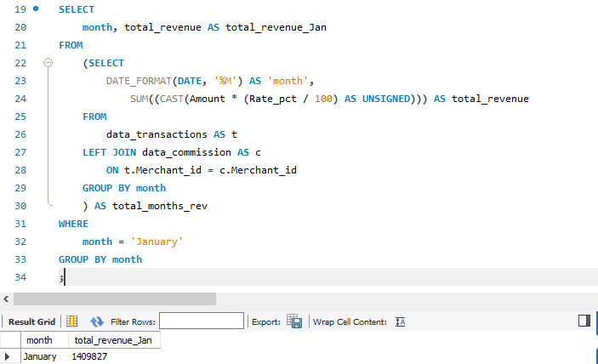
Part 1
Part 1.1
Total Revenue in January : ……1409827…….
Data : [https://github.com/atmen1997/Projects/tree/main/Momo]

Slide 5
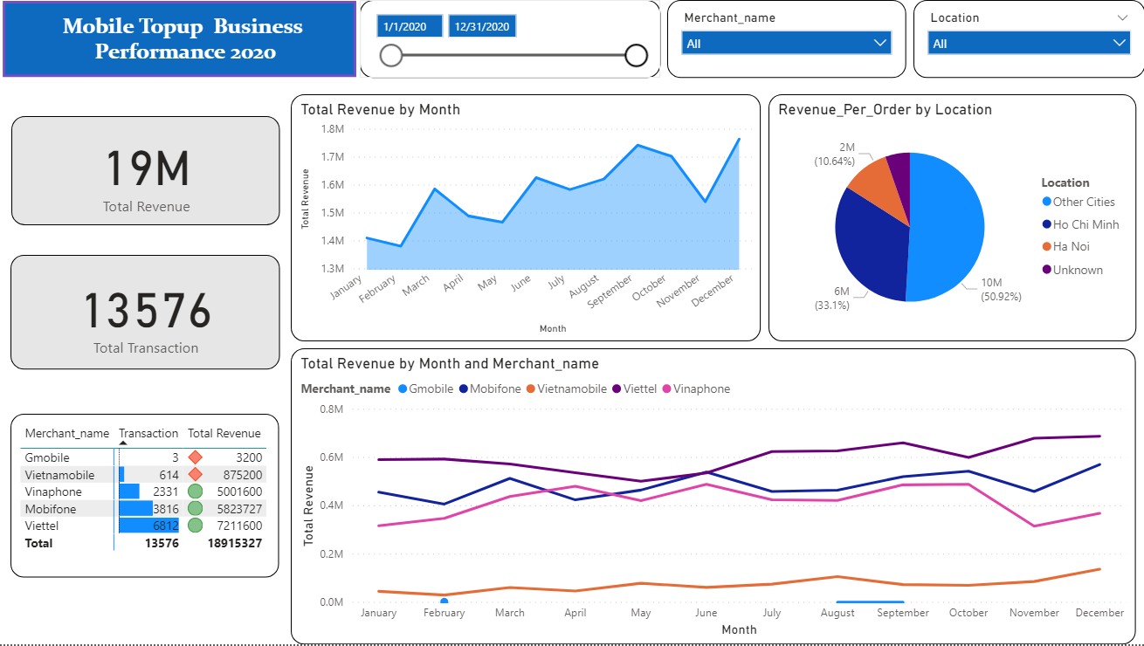
Part 1
https://github.com/atmen1997/Projects/tree/main/Momo
https://github.com/atmen1997/Projects/tree/main/Momo
[Put your performance dashboard below] https://github.com/atmen1997/Projects/tree/main/Momo

Slide 6
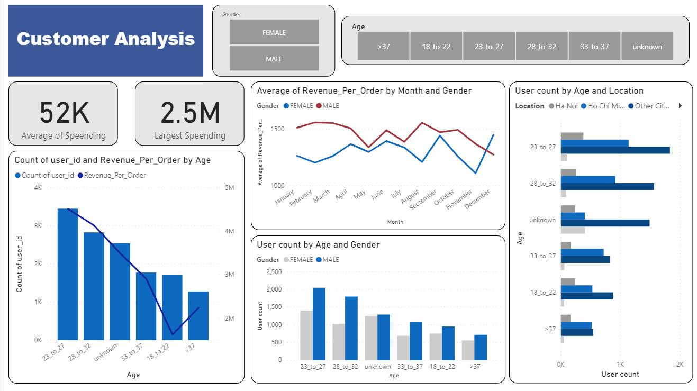
Part 1
https://github.com/atmen1997/Projects/tree/main/Momo
https://github.com/atmen1997/Projects/tree/main/Momo
[Put your performance dashboard below] https://github.com/atmen1997/Projects/tree/main/Momo

Slide 7
Part 2

Slide 8
Part 2.1
[Maximum 3 slides]
Base on the demographic, the majority of our users are male of who are in there mid 20s to early 30s with a big part living in HCM city and other cities in vietnam.
For the short run, I would suggest to continue to try an retain this group as it seems they are already using Momo Top-up extensively. There should be certain campaign exclusively for our female users, for example like coupon for topping-up, these coupons should also be for the Hanoi area as the user count are relatively lower compared to Ho chi Minh.

Slide 9
Part 2.2
[Maximum 2 slides]
I agree with these options, Zalo pay already have a 3% cash back on there top up so increasing the percentage is necessary in order to be competitive.
Viettel and mobifone are already at the top on the revenue and transactions hierarchy so increasing it to 2 and 2.5 is a good number.
However, Gmobile, and Vietnamobile might need a bigger increase as the numbers for those 2 are very low.

Slide 10
Part 3

Slide 11
Part 3.1
[Maximum 2 slides]
Now a days people are very much drawn to game, Candy Crush and many other simple games have captivated a lot of people.
Shoppe and many other commerce platform have implemented games into there mobile app. From personal experience, the people around me have been going onto shoppe much more because of the games.
These games create a habit for the users, which would make them go on the app more. The reward for playing and logging in daily are points that can be converted into special coupon deals.
I believe Momo should also have something similar to that, something more permanent than the yearly “Dap heo dat”, or something more exciting than Nuoi heo

Slide 12
Part 3.2
The size of largest relationship circles : …………………….
The number of largest relationship circles : …………………….
Algorithm Explanation : [Google Sheet/ Google Colab Link (if any)]

